Slide 1

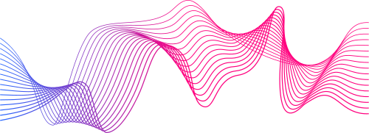
GENERATING IMAGE VARIATIONS FROM
TEXT
PRESENTED BY
20261A6607 - Ayman
20261A6653 - Anirudh

Slide 2



Exisiting Systems :
Lack of Semantic Understanding:
Current image variation techniques often do not understand the semantic content of the images. They apply transformations blindly, which may lead to unrealistic or nonsensical variations.
Inability to Capture Complex Patterns:
Simple geometric transformations may not capture complex patterns or relationships in the data, limiting the model's ability to learn intricate features. GPT lacks on bidirectional and classification, focusing on Text Classification
Adversarial Attacks:
Some variations might not effectively guard against adversarial attacks, where subtle manipulations can mislead a model. This is particularly crucial in security-sensitive applications.

Slide 3
Requirements Specification
Hardware Requirements:
Processor : Intel Core-i7
GPU : 12 GB
RAM : 16 GB
ROM : 256 GB
Software Requirements:
Operating System : Windows / MAC
Programing language : Python
IDE : Google Colaboratory

Slide 4
Abstract:
This project aims to develop a cutting-edge image generation system that leverages latent diffusers to create variations from text, enhancing the creative possibilities of digital art and design. The system will be built with a React frontend for user interaction and a Flask backend to manage the server-side operations. The project will also incorporate image inpainting capabilities, offering a significant upgrade over existing image generators
The key advantage of this project over existing image generators is its ability to create variations from text, offering a level of creativity and flexibility that is not commonly found in other tools. By allowing users to input text prompts, assign weights to the importance of text, provide positive and negative prompts and generate a range of images based on those prompts, this system opens up new possibilities for artistic expression and design. Additionally, the integration of image inpainting capabilities enhances the system's utility, making it a valuable tool for artists and designers alike. There are additional features that allow customisability of the output image apart from text such as image output dimensions i.e, the resolution, sampling steps in the image generation process etc.
The project’s significance lies in its potential to reshape multiple industries. From assisting designers in visualizing textual concepts with unprecedented fidelity to inspiring new avenues of artistic expression, the system’s applications are far- reaching. It can also serve as a tool for content creators to rapidly generate multimedia variations that align with specific textual cues.

Slide 5
Problems :
Limited Visual Conceptualization:
Designers and creative professionals struggle to visualize abstract textual concepts accurately, hampering the design process.
Artistic Constraints:
Artists and digital creators face limitations in translating text into intricate, unique images, restricting artistic expression.
Content Generation constraints:
Content creators and marketers find it challenging to generate multimedia variations aligned with specific textual cues efficiently.

Slide 6
Solutions :
Limited Visual Conceptualization:
Develop a robust text-to-image translation model using GANs and DCGANs.
Streamline the design process by transforming textual ideas into vivid visual representations.
Artistic Constraints:
Empower artists and digital creators to expand the boundaries of artistic expression.
Translate textual descriptions into intricate and unique images, fostering creativity and inspiration.
Content Generation constraints:
Assist content creators and marketers in rapidly producing multimedia variations.
Generate visuals and content that seamlessly align with specific textual cue

Slide 7
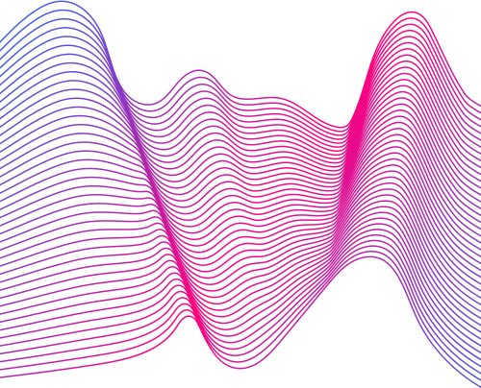
Literature survey
Year | Topic | Authors
2020 | Denoising Diffusion Probabilistic Models | Jonathan Ho, Ajay Jain
2015 | U-Net: Convolutional Networks for Biomedical Image Segmentation | Philipp Fischer
2021 | High-Resolution Image Synthesis with Latent Diffusion Models | Robin Rombach

Slide 8
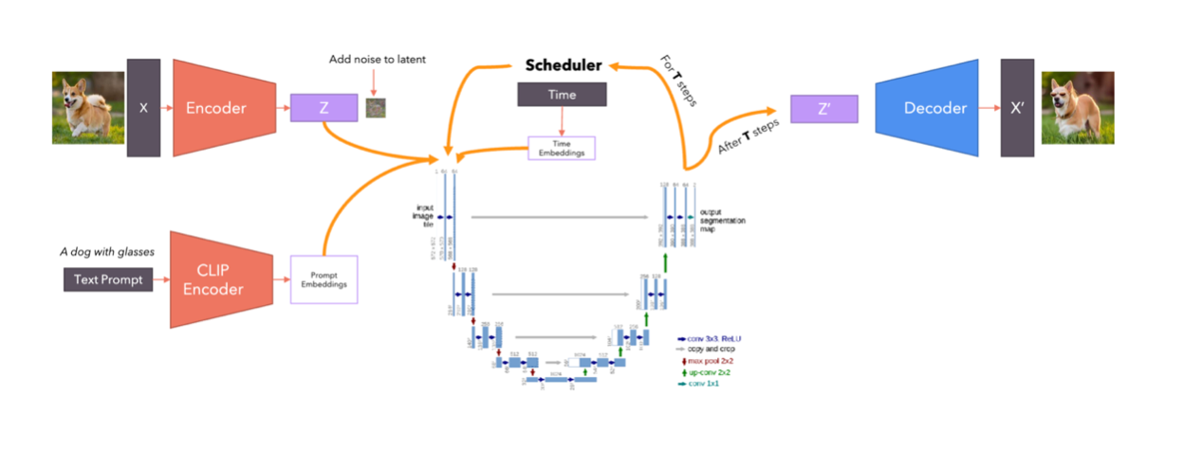
Latent Diffuser model

Slide 9
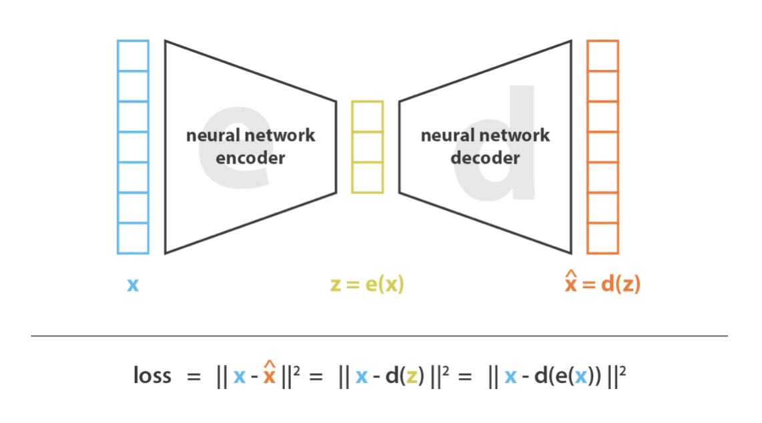
Variational Autoencoder

Slide 10
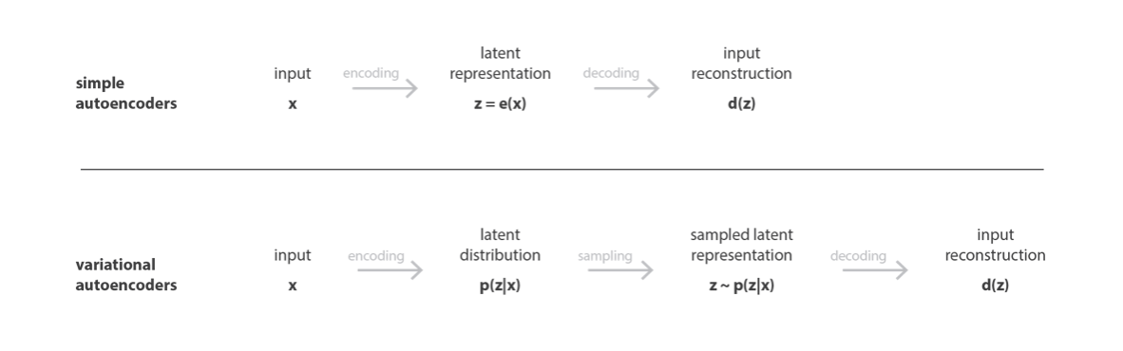
Why Variational Autoencoder?

Slide 11
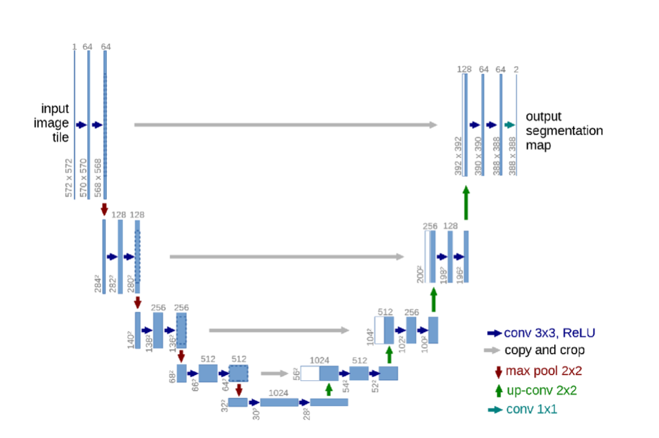
U-Net Architecture

Slide 12
U-Net Architecture

Slide 13
Denoising Diffusion Probabilistic Model (DDPM) Overview:
DDPM is a method used to train models to remove noise from images.
It involves two main processes: the forward process and the reverse process.
The DDPM Scheduler controls how noise is added and removed during training.
Forward Process:
Adding Noise:
Starts with a clean image.
Gradually adds noise to the image in a controlled, step-by-step manner.
This process is deterministic, meaning the noise added at each step is calculated precisely.
Noise Calculation:
The noise for each step is based on the noise from the previous step.
A Gaussian distribution is used to determine the noise, making the process predictable.
Reverse Process:
Removing Noise:
Begins with a noisy image.
Gradually removes noise to recover the original image.
This process is not deterministic; it relies on a neural network to predict the noise at each step.
Neural Network Involvement:
A U-Net architecture is typically used.
The U-Net predicts the mean and variance needed to reduce the noise and move towards a cleaner image.
This involves sampling from a Gaussian distribution to refine the image step-by-step.

Slide 14
Dataset Preparation:
LAION-5b Dataset Overview:
Size and Composition:
5.85 billion image-text pairs.
2.3 billion pairs in English.
2.2 billion pairs in over 100 other languages.
1 billion pairs with unknown language.
Features:
Tools for easy exploration and finding specific content.
Curated from extensive internet data.
Ensured to be safe and useful for research.
Advantages:
Open-source accessibility.
Supports diverse linguistic and contextual applications.

Slide 15
Applications:
Digital Art and Design: Artists can use the system to generate initial sketches and concepts from textual descriptions, speeding up the creative process
Advertising and Marketing: Marketers can generate visually appealing content for campaigns based on textual themes, enhancing creativity and engagement.
Film and Media Production: Directors and producers can visualize scenes and settings from script descriptions, improving planning and communication.
Education and E-Learning: Educators can create customized images and illustrations based on educational content, making learning more engaging.
Gaming Industry: Game developers can generate character designs and game environments from textual descriptions, speeding up the development process.

Slide 16
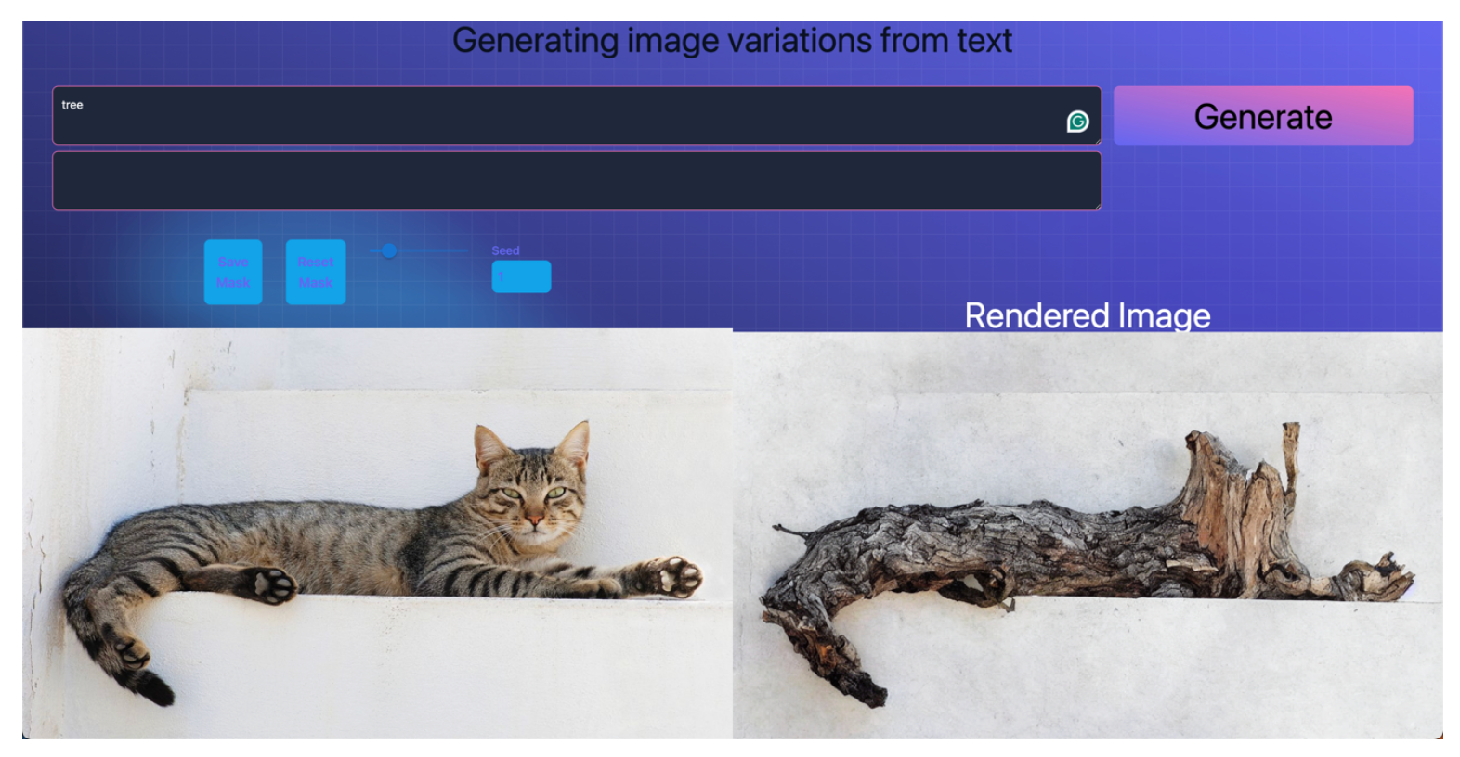
End Result

Slide 17
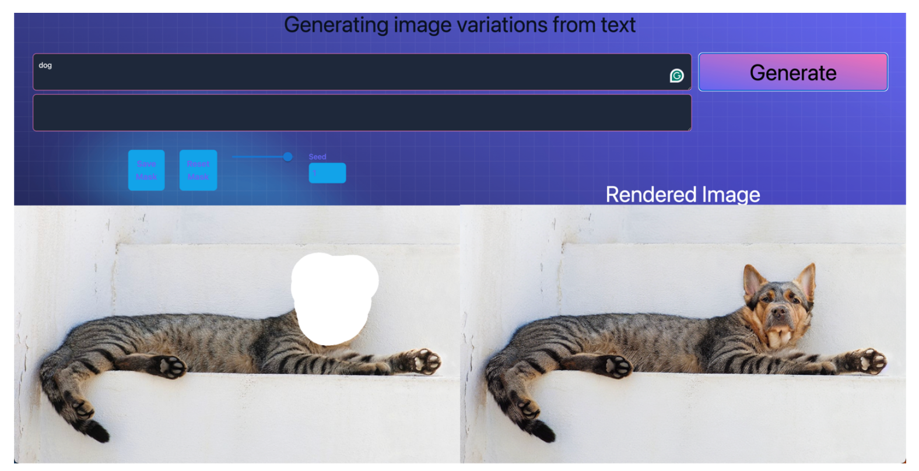
End Result

Slide 18

THANKS
20261A6607 - Ayman Mohammed
20261A6653 - TV Sai Anirudh

